Slide 1
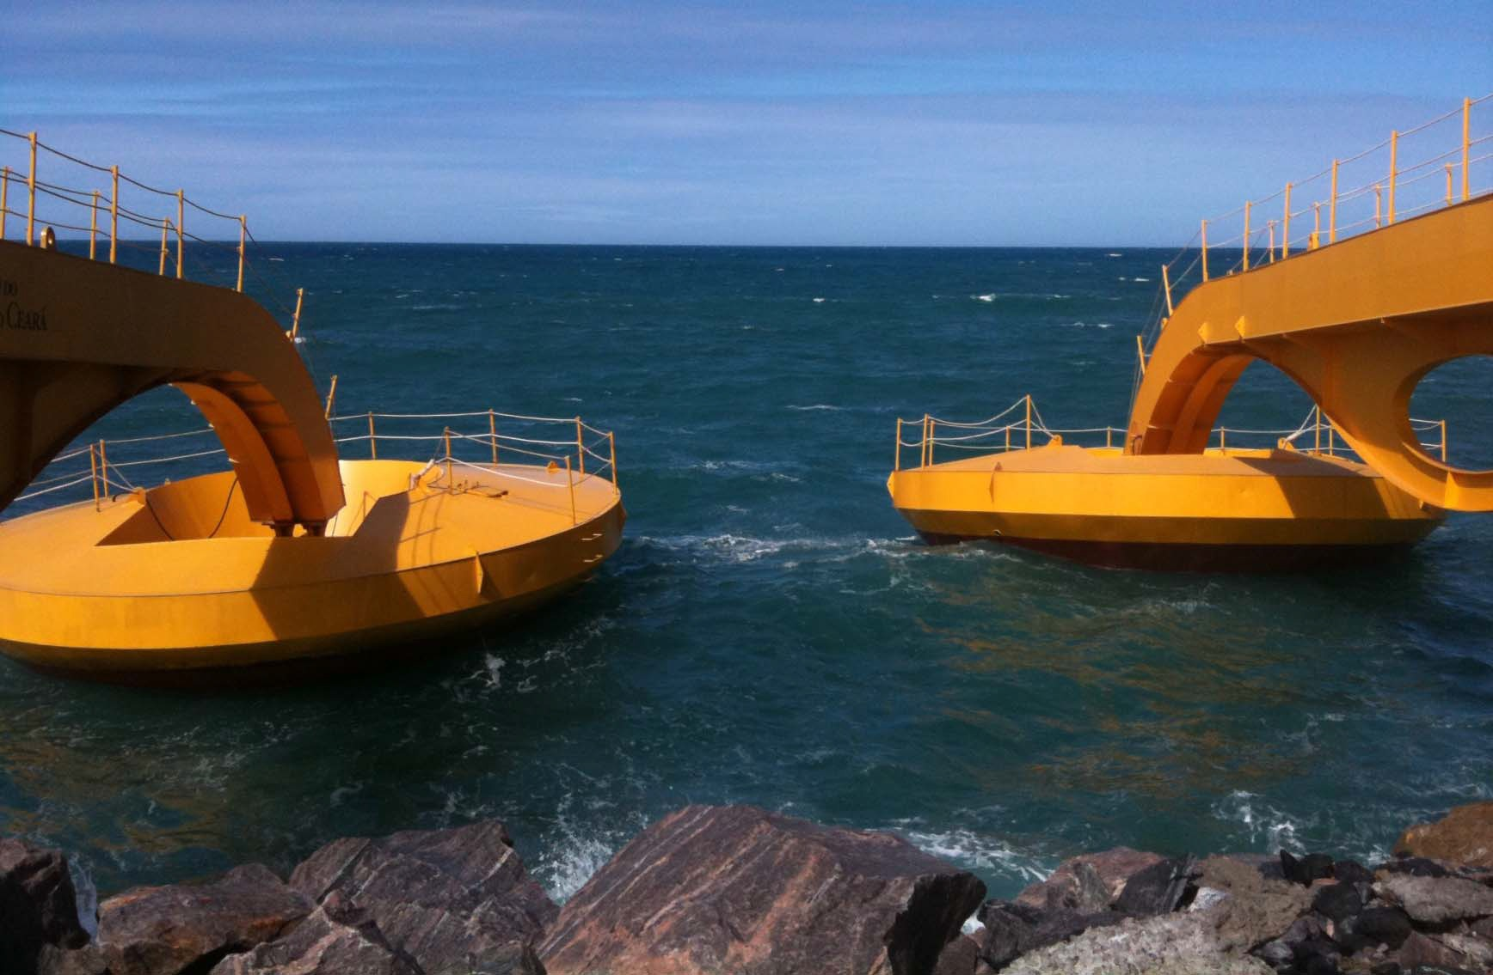
Wave Power Generator
Project features a land secured system that reaches into the ocean and harvests the motion of the waves, converting the kinetic energy into clean electricity

Slide 2
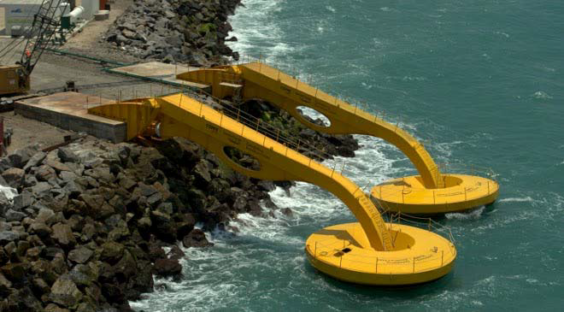
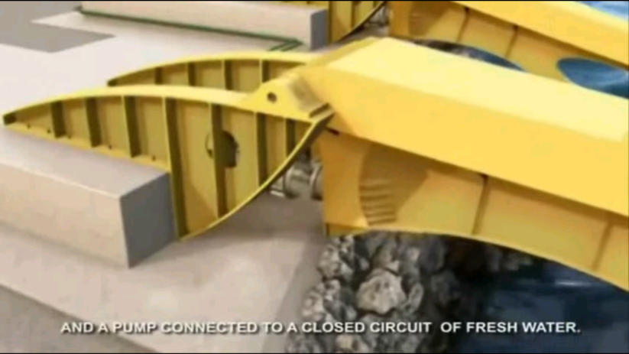

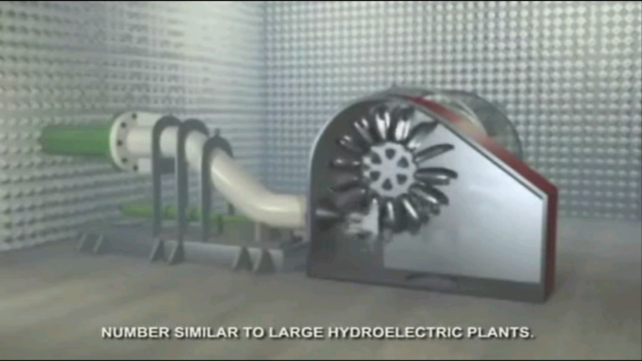
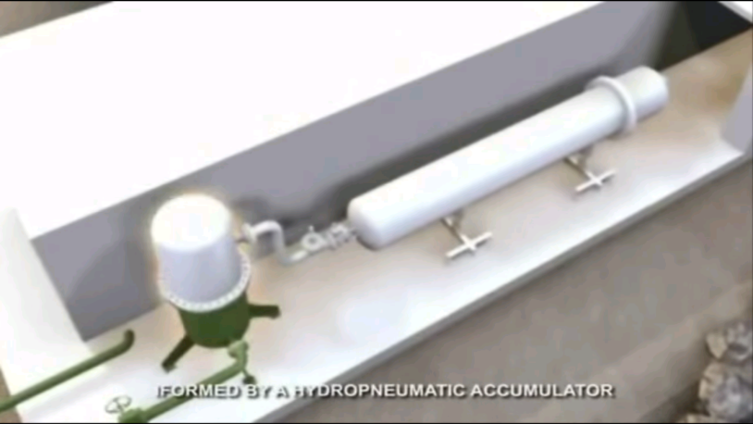
On-shore Wave Energy Converter
Buoy vertical muvement
Water pump
Turbine generator
Hyperbaric chamber

Slide 3
Feasibility
Dimensions: floating disc module consists of a 10 meter diameter floating buoy attached to a 22 meter long arm
Installed turbine capacity: 5 MW/hour.
Developer: Technology Laboratory and EDINA KRAINA Fond
Project cost: about USD 3.5(three and half) million for two subunits module (UNIT)
Advantages of technology for Africa:
1. Simple and reliable construction
2. Minimum environmental footprint for water and on-shore area
3. Absence of hazardous or dangerous components
4. Minimal area requirements
5. Minimal requirements for implementation
6. Very low cost of electricity generated
7. Simplicity in the possibility of project multiplication.

Slide 4
BRIEF FINANCIAL CALCULATION OF THE PROJECT
*Unit capacity at two turbines of total power 5 Mwt/hour one:
Daily – 120 Mwt. / Monthly – 3600 Mwt.
* Performance of a cascade of ten units:
Monthly – 36000 Mwt. / Annual – 432.000 Mwt.
* Cost per unit – USD 3.500.000.00
* Cost per cascade of ten units – USD 35.000.000.00
* Expected cost of electricity produced by cascade of 10 units (at the expected rate USD 0.07/Kwt) – USD 32.400.000/annually
* Expected realizable value of electricity generated by 10 units (at minimum selling price USD 0.11/Kwt) – USD 47.520.000/annually
* Expected profit – USD 17.280.000/annually.
Thus, Project should pay off and start generating profit within 2 years.

Slide 5
Conditions for the implementation of this project in Guinea and the Gulf of Guinea countries.
Our Foundation in the Gulf of Guinea, with the assistance of a German specialized company, carried out a full range of scientific and research studies to confirm the physical conditions for the Project implementation (the prefeasibility study report exist) :
Presence of constant sea waves of the required amplitude
Absence of storms and hurricanes in the water area
Temperature regime without sharp fluctuations
The Gulf of Guinea coastal States, like all African States, are characterized by power generation problems and persistent power shortages.
The average annual electricity demand for Conakry (Guinea’s capital) is about 3600000 Mwt.
Thus, a cascade of 10 units will be able to cover the annual demand of the capital and the surrounding regions. And when the cascade is expanded to several dozen units, we will be able to export electricity to neighboring countries of the continent.

